Slide 1
Overview and Demo of CaIntegrator2
A Tool for Publishing and Analyzing Integrated Study Data

Slide 2
caIntegrator2 Goals
Have a single place where one can go to get all the information about a study
Clinical Data
Imaging Data
Genomic Data
Provide ways to browse and analyze the data
Explore and confirm hypotheses
Publish results and lists, e.g. of interesting genes
Have a way to roll out new studies easily
Have a consistent user experience across different studies
Lay the groundwork for cross-study comparisons

Slide 3
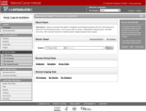


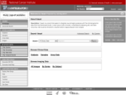




How caIntegrator2 works
Software Development Team
Study Team
Public
pre-alpha release
View Study
Array Data
caIntegrator2
Study Team
Spread-sheet
Deploy Study
Study Manager
Clinical Data
Images
Image Annotations
Spread-sheet
Image Annotations
AIM
Tissue Data
1.0 release

Slide 4
Overview and Demo of CaIntegrator2
A Tool for Publishing and Analyzing Integrated Study Data

